Slide 1
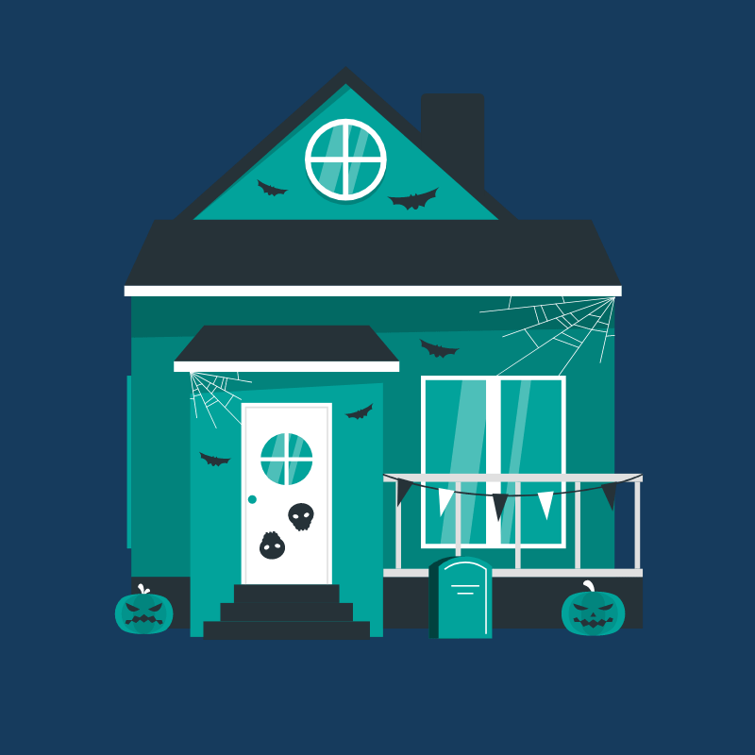
HALLOWEEN
Tudor Tripa, Fifth Grade

Slide 2
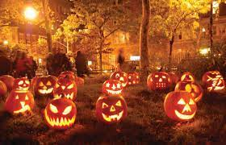
1.What’s Halloween?...
Halloween or Hallowe'en less commonly known as Allhalloween,All Hallows' Eve, or All Saints' Eve, is a celebration observed in many countries on 31 October.

Slide 3
2. What do you do at Halloween?
I
II
Trick or Treat
Carving Pumpkins (Jack’o lanterns
In the evening before All Saints' Day (1 November), children in costumes go from house to house, asking for treats with the phrase "Trick or treat".
“Their origin comes from an Irish myth about Stingy Jack, who tricked the Devil for his own monetary gain. When Jack died, God did not allow him into heaven, and the Devil did not let him into hell, so Jack was sentenced to roam the earth for eternity. In Ireland, people started to carve demonic faces out of turnips to frighten away Jack's wandering soul.”

Slide 4
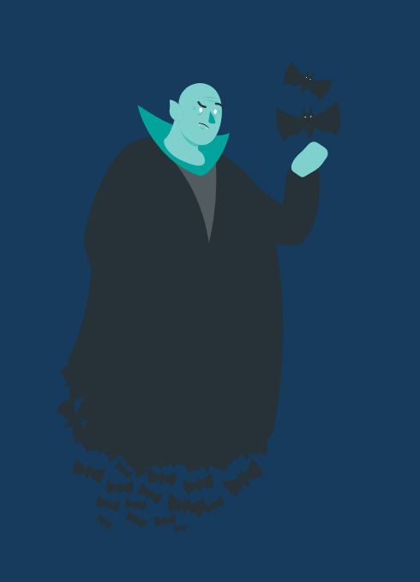
“I love Halloween, and I love that feeling: the cold air, the spooky dangers lurking around the corner.”
— Evan Peters
"Halloween was the best holiday, in my opinion, because it was all about friends, monsters, and candy, rather than family and responsibility."
– Margee Kerr
"Halloween was confusing. All my life my parents said, 'Never take candy from strangers.' And then they dressed me up and said, 'Go beg for it.'"
– Rita Rudner
“Some people are born for Halloween, and some are just counting the days until Christmas.”
— Stephen Graham Jones
3.Quote’s about Halloween

Slide 5


Traditions over the world
Ireland
samhain
Italy
ognissanti
Mexico
Japan
dia de los muertos
kawasaki halloween parade

Slide 6
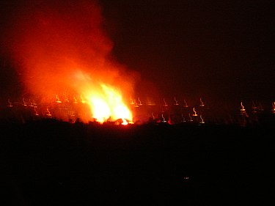
Samhain
Samhain is an ancient pre-Christian holiday.

Slide 7
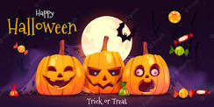
Ognissanti
“Ognissant” translates to “All Saint’s Day,” and it falls on November 1-2. However, people often begin the celebrations a day or two in advance.
During Ognissanti, tradition holds that the souls of the deceased come back to visit their living relatives. People decorate cemeteries with fall chrysanthemums. They leave food out for visiting spirits. In some parts of Italy, parents leave gifts out for their children on behalf of their dead relatives, almost like a miniature Christmas.

Slide 8
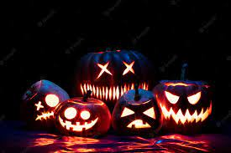
Dia de los muertos
In Mexico, Halloween doesn’t hold a candle to El Día de Los Muertos, the Day of the Dead.
A colorful fusion of traditional indigenous customs and European traditions, Día de Los Muertos is a two-day celebration of ancestors and deceased family members.
According to legend, on November 1st and 2nd, the spirits of the dead come back to visit their families. The living celebrate them with flowers, festivals, sweets, and images of intricately decorated skulls and skeletons. They have picnics and light candles in cemeteries. While images of death are everywhere, it's important to understand that this isn't a scary or a sad holiday- it's a celebration of life, both past, and present.

Slide 9
Kawasaki halloween parade
Around the the world, Halloween is generally for kids. Not true in Japan, where Halloween celebrations have a decidedly adult overtone. There's no trick-or-treating, but there's plenty of cosplay and plenty of parties. Halloween celebrations have already caused chaos in Tokyo this year, and the day itself hasn’t even arrived yet.
The most prestigious Halloween event in Japan is the Kawasaki Halloween Parade, featuring around 4,000 costumed revelers. You can't just throw on any old thing and attend, however. They have standards, and participants must apply at least two months in advance to join the festivities.

Slide 10
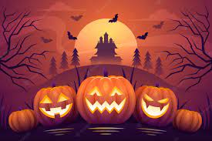
THANK YOU
4 WATCHING!

