Slide 1

THE MOST INNOVATIVE SCHOOLS AROUND THE WORLD
Tripa Tudor 6th Grade

Slide 2
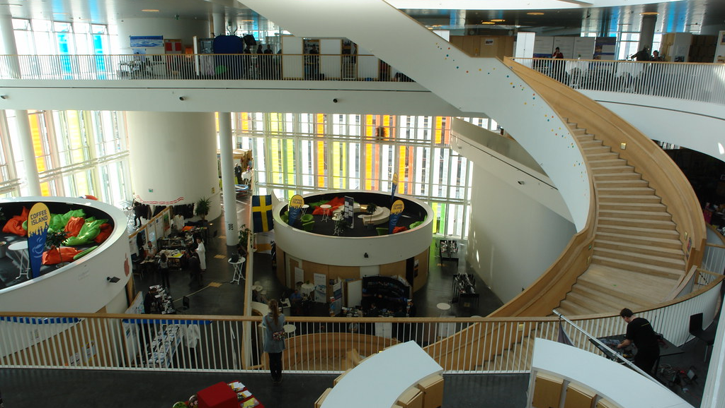
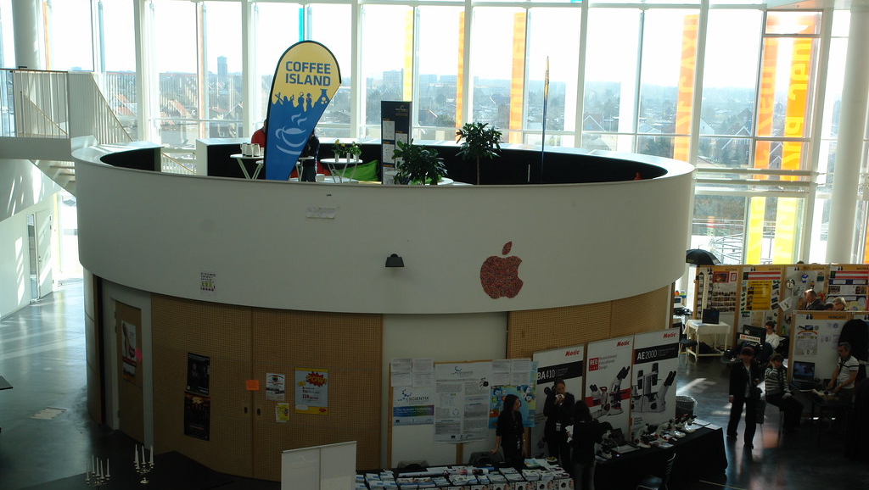
1. Ørestad Gymnasium
Ørestad Gymnasium is an innovative high school in Copenhagen, Denmark, established in 2005. It focuses on media, communications, and culture while offering specialized programs in natural sciences, social studies, and humanities. The school’s design features an open, flexible learning environment with no traditional classrooms. Instead, it has group areas, pods, stairs, and bookshelves to encourage collaboration and movement.
The school emphasizes creativity, innovation, and interaction between students and teachers. Key features include “fat boy areas” with bean bags for relaxation, and various learning settings such as traditional classes, group work, and digital learning.

Slide 3
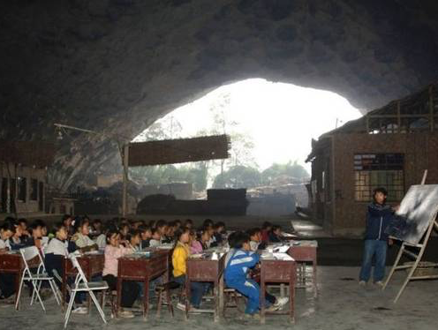
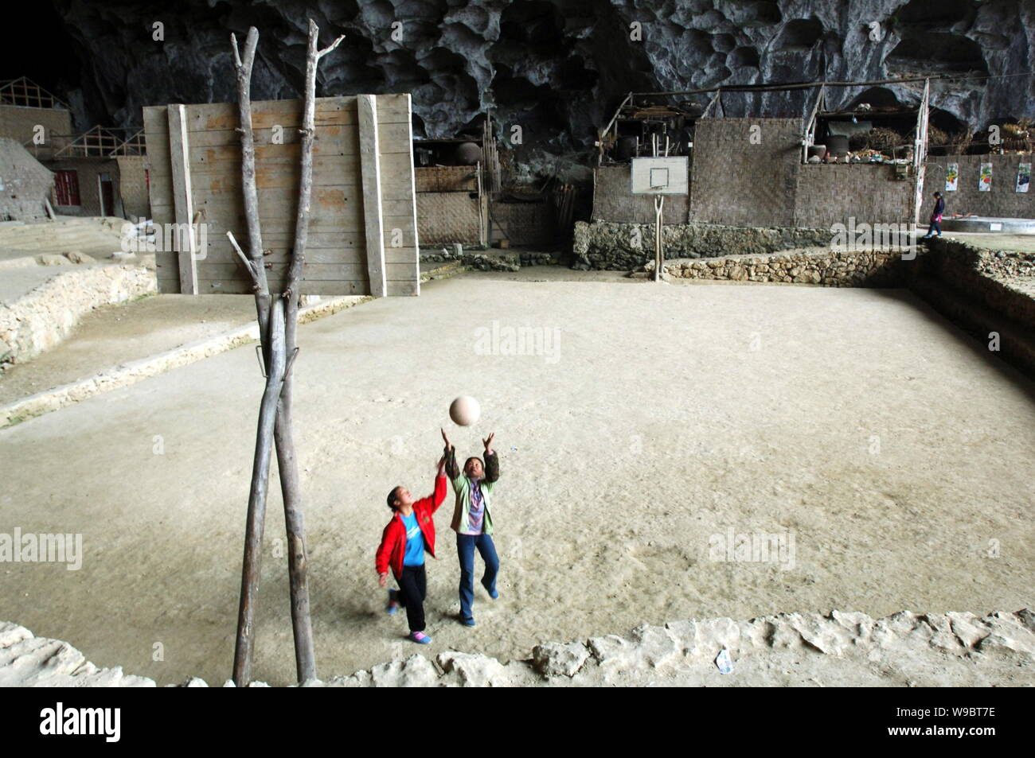

2. Dongzhong Mid-Cave Primary School
It’s located in a cave in the mountainous Miao village in China. Dongzhong itself means "in cave". ocated in a cave in the mountainous Miao village in China. Dongzhong itself means "in cave".

Slide 4



The school without books
The West Philadelphia School of the Future, opened in 2006, replaces traditional textbooks with computers and uses technology like OneNote for teaching mathematics and smart boards in classrooms. Digital lockers are accessed with ID cards. Despite early challenges with both students and teachers adapting to the technology, the school has become successful, with students achieving high marks in math and reading. The school operates on a workday schedule, from 9:00 am to 4:00 pm.

Slide 5
Thanks for watching

