Slide 1
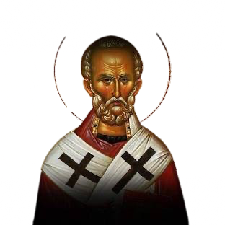
St.Nicholas
Tripa Tudor

Slide 2

Legend of St. Nicholas
The legend of Santa Claus can be traced back hundreds of years to a monk named St. Nicholas. It is believed that Nicholas was born sometime around A.D. 280 in Patara, near Myra in modern-day Turkey. Much admired for his piety and kindness, St. Nicholas became the subject of many legends. It is said that he gave away all of his inherited wealth and traveled the countryside helping the poor and sick. One of the best-known St. Nicholas stories is the time he saved three poor sisters from being sold into slavery or prostitution by their father by providing them with a dowry so that they could be married.

Slide 3
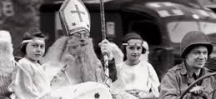
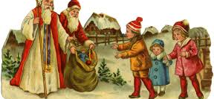
St. Nicholas in U.S.A
In the United States, one custom associated with Saint Nicholas Day is children leaving their shoes in the foyer on Saint Nicholas Eve in hope that Saint Nicholas will place some coins on the soles.
The American Santa Claus, as well as the British Father Christmas, derive from Saint Nicholas. "Santa Claus" is itself derived in part from the Dutch Sinterklaas, the saint's name in that language. However, the gift giving associated with these descendant figures has come to be associated with Christmas Day rather than Saint Nicholas Day itself.

Slide 4
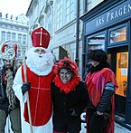
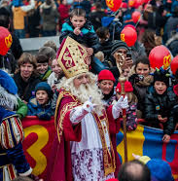
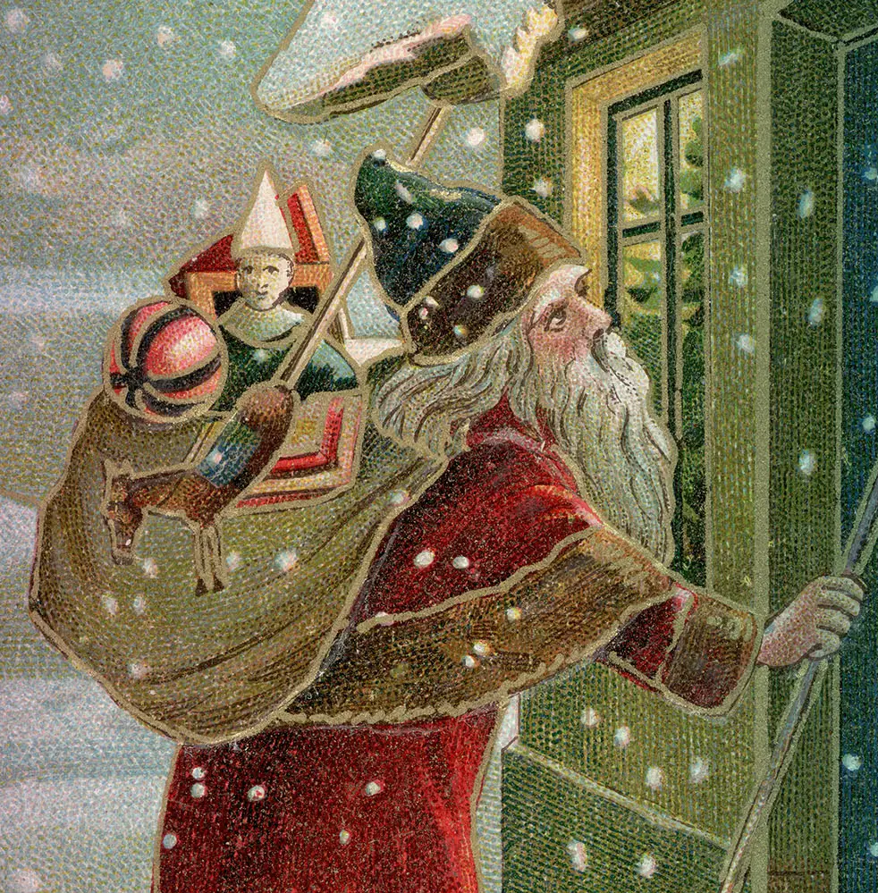
St. Nicholas in Europe
Saint Nicholas is venerated across various cultures, each with unique traditions. In Albania, he's known as Shen'Kollë, celebrated with feasts of roasted lamb and pork. In Greece, he is the patron saint of sailors, celebrated aboard ships. In Serbia, his feast, Nikoljdan, involves fasting. Bulgarians celebrate with fish dishes on Nikulden. In the Netherlands, Sinterklaas arrives from Spain, with children finding gifts in their shoes. Belgium celebrates on 6 December, with Sinterklaas arriving in Antwerp. Luxembourg's De Kleeschen visits schools. Slovenia and Croatia have traditions involving gifts and Krampus. In Hungary, Croatia, Slovakia, Ukraine, and Romania, children leave their boots out for candies from Moș Nicolae. In France, Saint Nicholas revives children from a wicked butcher's tub. Traditions often emphasize charity, as seen in Ukraine's Saint Nicholas Factory, and modern adaptations include the film "The Adventures of St. Nicholas."

Slide 5
Thanks for watching

