Slide 1

Programing apps
Tudor Tripa
Prof. Aranka Mester

Slide 2
Programing apps
Name | Availibility | Level of programing
Visual Studio | Windows/Mac | Advanced
CodeBlocks | Windows | Advanced
Scratch | Online | Medium
Blockly | Online | Medium
CodeMonkey | Online | Medium
LightBot | Online | Medium
Mimo | Online | Medium
Scratch Jr | Android/Ios | No level needed

Slide 3
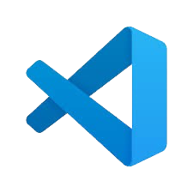
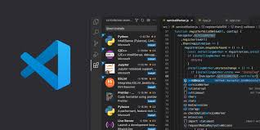
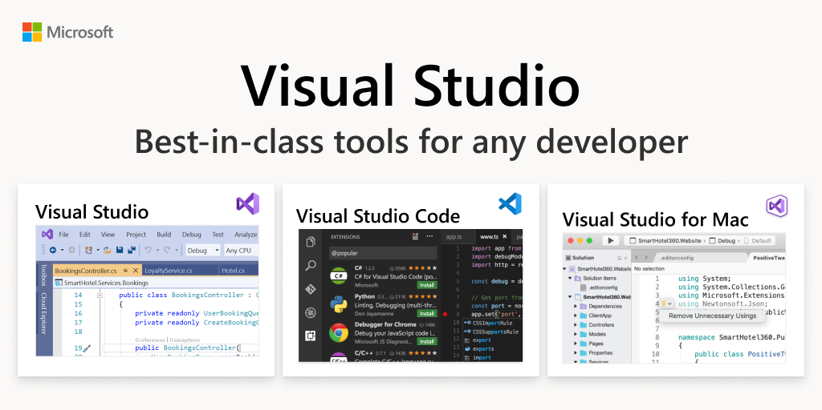
Visual Studio
Microsoft Visual Studio is a comprehensive integrated development environment (IDE) from Microsoft, used for creating applications across various platforms like Windows, Android, iOS, web, and cloud services. Supporting multiple programming languages such as C#, VB.NET, F#, and C++, it offers features like code editing, debugging, profiling, and version control integration. Notable features include IntelliSense for code completion and advanced debugging tools. Visual Studio is available in free Community edition for individuals and open-source projects, as well as Professional and Enterprise editions for larger teams and enterprises.

Slide 4
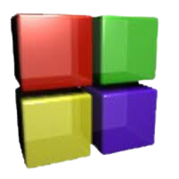
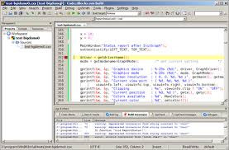
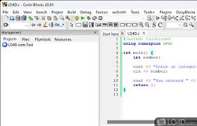
CodeBlocks
Code::Blocks is a free, open-source integrated development environment (IDE) designed for C, C++, and Fortran programming. It offers a customizable interface, supports multiple compilers such as GCC and Clang, and provides features like syntax highlighting, debugging, and project management. Code::Blocks is cross-platform, running on Windows, macOS, and Linux, making it a versatile choice for developers. Its extensible plugin architecture allows users to enhance functionality as needed. Perfect for both beginners and experienced programmers, Code::Blocks helps streamline the coding and debugging process efficiently.

Slide 5
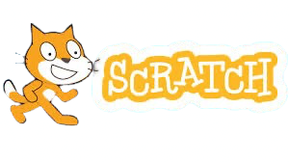
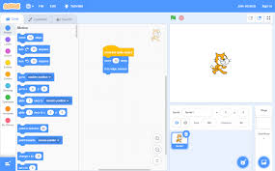

Scratch is a free, visual programming language developed by MIT Media Lab that enables children and beginners to create interactive stories, games, and animations. Users program by snapping together blocks of code, making it an intuitive way to learn the basics of coding and logic. Scratch supports a community where users can share their projects and get feedback

Slide 6
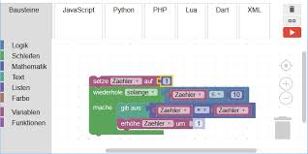

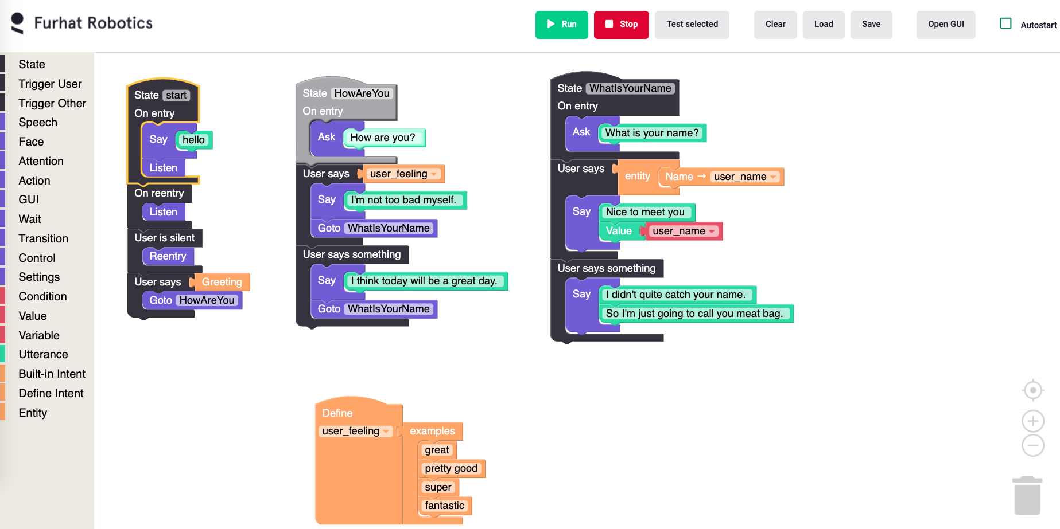
Blockly: Blockly is a visual programming editor developed by Google, designed to teach coding concepts through a block-based interface. Users drag and snap blocks together to build programs, making it an accessible way for beginners to learn the logic and structure of coding without needing to write actual code.

Slide 7
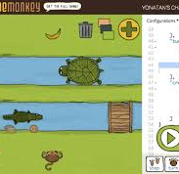
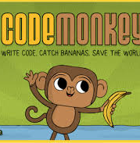
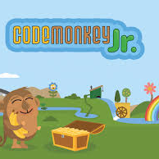
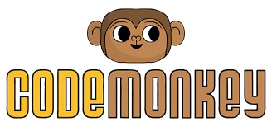
CodeMonkey is an educational platform that teaches coding through fun, game-based challenges. Players help a monkey collect bananas by writing code, learning programming concepts such as loops, variables, and functions in a playful and engaging way. It's suitable for children and beginners who want to start coding.

Slide 8
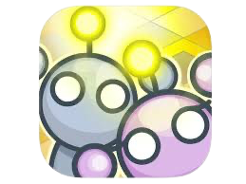
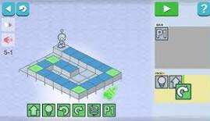
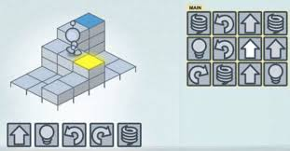
LightBot
LightBot is a puzzle game that introduces players to programming principles. Users guide a robot through mazes by setting commands in a sequence, learning about procedures, loops, and conditionals in a hands-on manner. It's an excellent tool for kids to develop problem-solving skills and understand basic coding concepts.

Slide 9
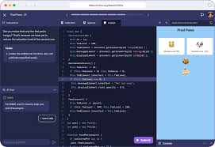
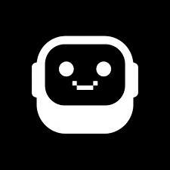
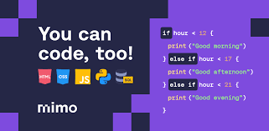
Mimo
Mimo is a mobile app that offers interactive lessons on various programming languages and topics. It covers everything from basic coding to web development and data science, making learning fun and accessible. With bite-sized exercises and real-world projects, Mimo is great for anyone looking to learn coding on the go.

Slide 10
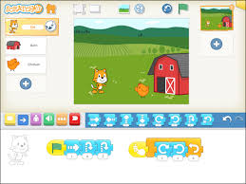
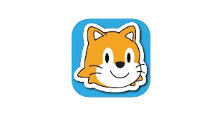
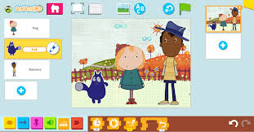
Scratch Jr.
ScratchJr is a simplified version of Scratch designed for younger children, ages 5-7. It introduces the fundamentals of programming through an easy-to-use interface and playful, visual blocks. Kids can create their own interactive stories and games, helping them develop problem-solving and sequencing skills at an early age. ScratchJr runs on tablets and is perfect for introducing coding to young learners.

Slide 11

Thanks for watching!

