Slide 1
New York
TUDOR TRIPA

Slide 2
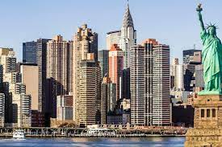
Population
With a 2020 population of 8,804,190, New York City is the most densely populated major city in the United States and more than twice as populous as Los Angeles, the nation's second largest city.
As of 2022, New York is home to the highest number of billionaires and millionaires of any city in the world.

Slide 3
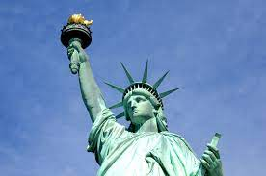
Statue of liberty
The Statue of Liberty (; French: La Liberté éclairant le monde is a sculpture on Liberty Island in New York Harbor in New York City, United States. The copper statue, a gift from the people of France, was designed by French sculptor Frédéric Auguste Bartholdi and its metal framework was built by Gustave Eiffel. The statue was dedicated on October 28, 1886.
The statue is a figure of Libertas, a robed Roman liberty goddess. She holds a torch above her head with her right hand, and in her left hand carries a book inscribed JULY IV MDCCLXXVI: July 4, 1776 in Roman numerals, the date of the U.S. Declaration of Independence

Slide 4
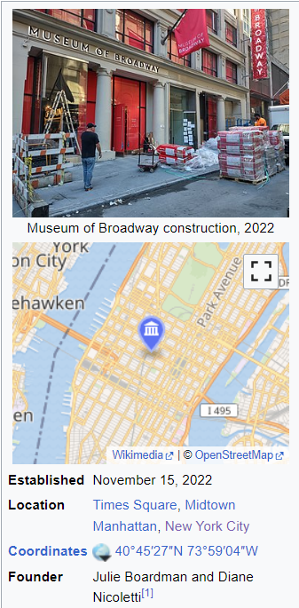
Museum of Broadway
The Museum of Broadway, on West 45th Street in Times Square, is the first permanent museum dedicated to documenting the history and experience of Broadway theatre and its profound influence upon shaping Midtown Manhattan and Times Square. The museum covers more than three hundred years of Broadway history, including costumes and props from more than 500 productions. The Museum of Broadway was founded in collaboration with Playbill, Broadway Cares/Equity Fights AIDS, the Billy Rose Theatre Division at the New York Public Library for the Performing Arts, the Al Hirschfeld Foundation, Goodspeed Musicals, Creative Goods, and Concord Theatricals.

Slide 5
World Trade Center (1973–2001)
The original World Trade Center (WTC) was a large complex of seven buildings in the Financial District of Lower Manhattan in New York City. It opened on April 4, 1973, and was destroyed in 2001. At the time of their completion, the Twin Towers—the original 1 World Trade Center (the North Tower) at 1,368 feet (417 m); and 2 World Trade Center (the South Tower) at 1,362 feet (415.1 m)—were the tallest buildings in the world. Other buildings in the complex included the Marriott World
Trade Center (3 WTC), 4 WTC, 5 WTC, 6 WTC, and 7 WTC. The complex contained 13,400,000 square feet (1,240,000 m2) of office space and, prior to its completion, was projected to accommodate an estimated 130,000 people.

Slide 6
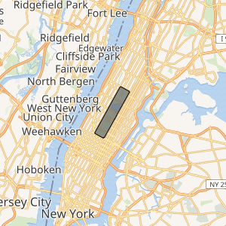
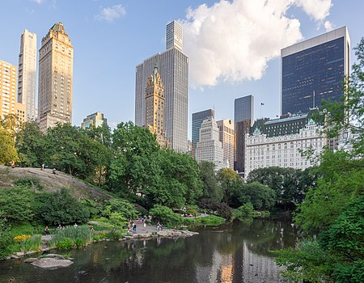
Central Park
Central Park is an urban park in New York City located between the Upper West and Upper East Sides of Manhattan. It is the fifth-largest park in the city, covering 843 acres (341 ha). It is the most visited urban park in the United States, with an estimated 42 million visitors annually as of 2016, and is the most filmed location in the world.
After proposals for a large park in Manhattan during the 1840s, it was approved in 1853 to cover 778 acres (315 ha). In 1857, landscape architects Frederick Law Olmsted and Calvert Vaux won a design competition for the park with their "Greensward Plan".

Slide 7
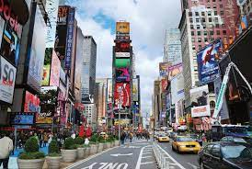
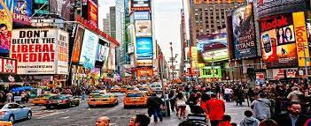
Times Square
Times Square is a commercial intersection, tourist destination and neighborhood in Midtown Manhattan, N.Y. Together with adjacent Duffy Square, Times Square is a bowtie-shaped space, five blocks long between 42nd and 47nd Streets.
All over Times Square are brightly lit digital billboards that are lit non-stop. Sometimes Times Square is referred to as the Crossroads of the world.

Slide 8
Thanks 4 watching!!

