Slide 1
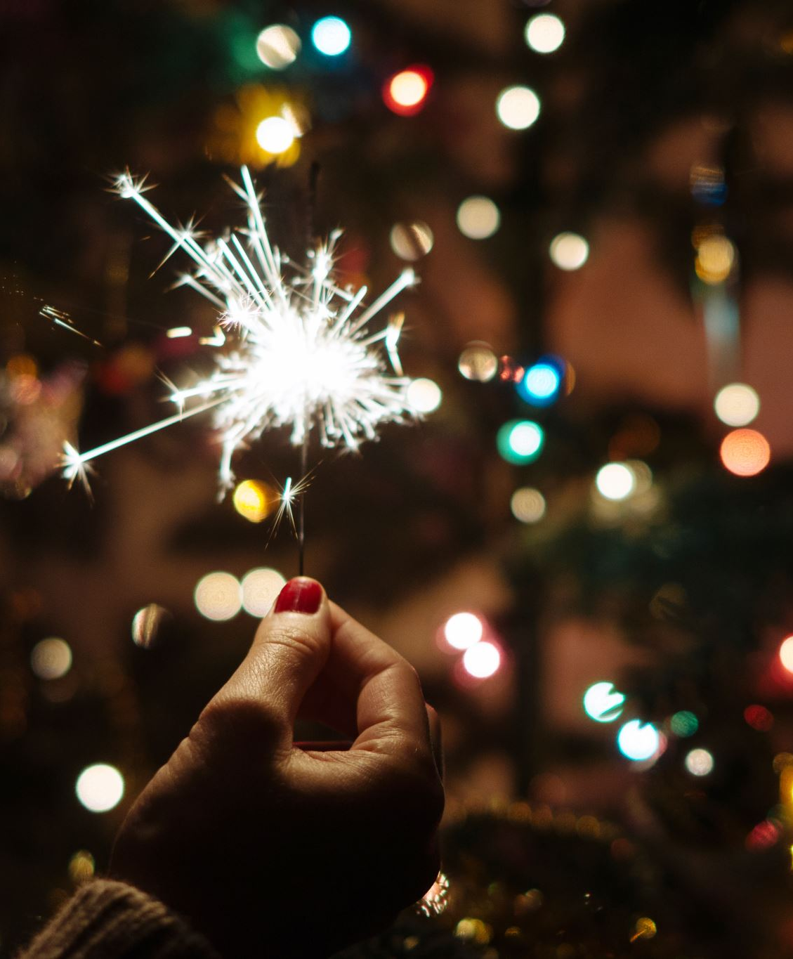
New Year's Eve
Tudor Tripa
Grade 6E

Slide 2
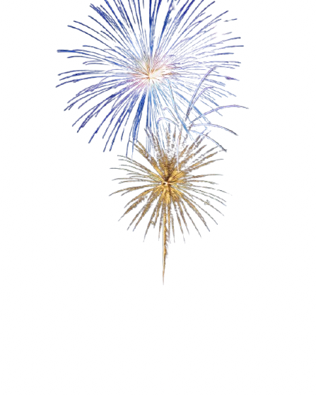
Other Names
Hogmanay (Scotland)
Calennig (Wales)
Shchedryi Vechir (Ukraine)
Ambang/Malam Tahun Baharu/Baru (Brunei, Indonesia, Malaysia, Singapore)
Yangi Yil, Yılbaşı arifesi, Yeni İl ərəfəsi (Uzbekistan, Turkey and Azerbaijan)
Karamu (African diaspora)
Silvester (Austria, Bosnia and Herzegovina, Croatia, Czech Republic, France, Germany, Hungary, Israel, Italy, Liechtenstein, Luxembourg, Poland, Russia, Serbia, Slovakia, Slovenia, Switzerland)
Réveillon (Algeria, Angola, Brazil, France, Macau, Morocco, Mozambique, Portugal, Romania, Tunisia, Wallonia, and French-speaking locations in North America)
Kanun Novogo Goda (Russia)
Ōmisoka (Japan)
Pele ga Ngwaga o Mosha(Botswana)
Nochevieja (lit. Old Night) (Spain and other countries where Spanish is mostly spoken)

Slide 3
How is N.Y.E. celebrated in Algeria
In Algeria, New Year's Eve is usually celebrated with family and friends. In the largest cities, there are fireworks at midnight. The Martyrs' Memorial is the main attraction during the celebration, while some Algerians prefer celebrate outside the country, generally in Tunis or Paris
At 8 PM (AST), the President's message of greetings is read on TV. The EPTV network airs an entertainment show, with different hosts and guests

Slide 4
How is N.Y.E. celebrated in Tunisia
In Tunisia, Tunisians celebrate by spending the evening in restaurants and hotels and exchange gifts and flowers, or travel outside Tunisia to spend New Year's Eve in a European country. But most Tunisians prefer to celebrate it at home in a family evening with relatives and friends.
Tunisians buy cakes or prepare them at home, in addition to holding dinner banquets, as roast chickenremains the main dish for this occasion, and staying up until midnight to eat cake as the first moments of the new year arrive.
In recent years, the popular Tunisian film Choufli Hal on New Year's Eve is broadcast every year, ending just minutes before the new year. This has become an annual tradition.

Slide 5
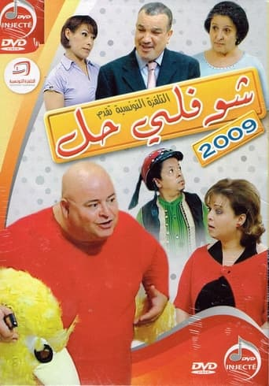
What is Choufli Hal, le réveillon ?
Choufli Hal, le réveillon (Arabic: شوفلي حل في رأس العام ) is a Tunisian telefilm inspired by the series Choufli Hal. Written by Hatem Bel Hadj and directed by Abdelkader Jerbi, it was broadcast on April 4, 2009, on the national channel Tunisie 7

Slide 6
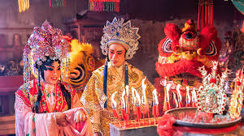
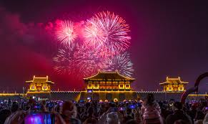
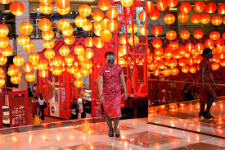
How is N.Y.E. celebrated in China
In China, although the celebrations of the Lunar New Year are not until a few weeks after the Gregorian New Year, celebrations of the Gregorian New Year are held in some areas, particularly in major cities. For example, celebrations with fireworks and rock concerts have taken place in Beijing's Solana Blue Harbor Shopping Park, while cultural shows and other events are held at the city's Millennium Monument, Temple of Heaven, Great Wall of China, Olympic Green, and the Summer Palace. Since 2011, a light and sound show has been held at The Bund in Shanghai, a few minutes before midnight.

Slide 7
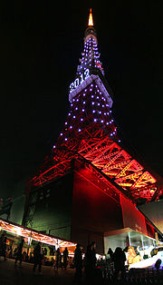
How is N.Y.E. celebrated in Japan
In Japan, New Year's Eve involves preparing for Toshigami, the New Year's god, with home cleaning and setting up Kadomatsu or Shimenawa. Buddhist temples ring bells 108 times at midnight, symbolizing the elements of bonō. Celebrations include concerts, countdowns, and fireworks. In Tokyo, people gather at Zojoji Temple, releasing helium balloons and watching the lighting of Tokyo Tower and Tokyo Skytree. Shibuya Crossing's gathering ended in 2020 due to the COVID-19 pandemic and crowd issues. Notable TV specials include NHK's Kōhaku Uta Gassen, the Japan Record Awards on TBS, and Johnny's Countdown on Fuji TV. Combat sports events at Saitama Super Arena, initially by Pride Fighting Championships and later by Rizin Fighting Federation, have become a New Year's tradition.

Slide 8
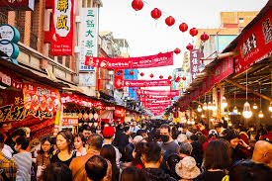
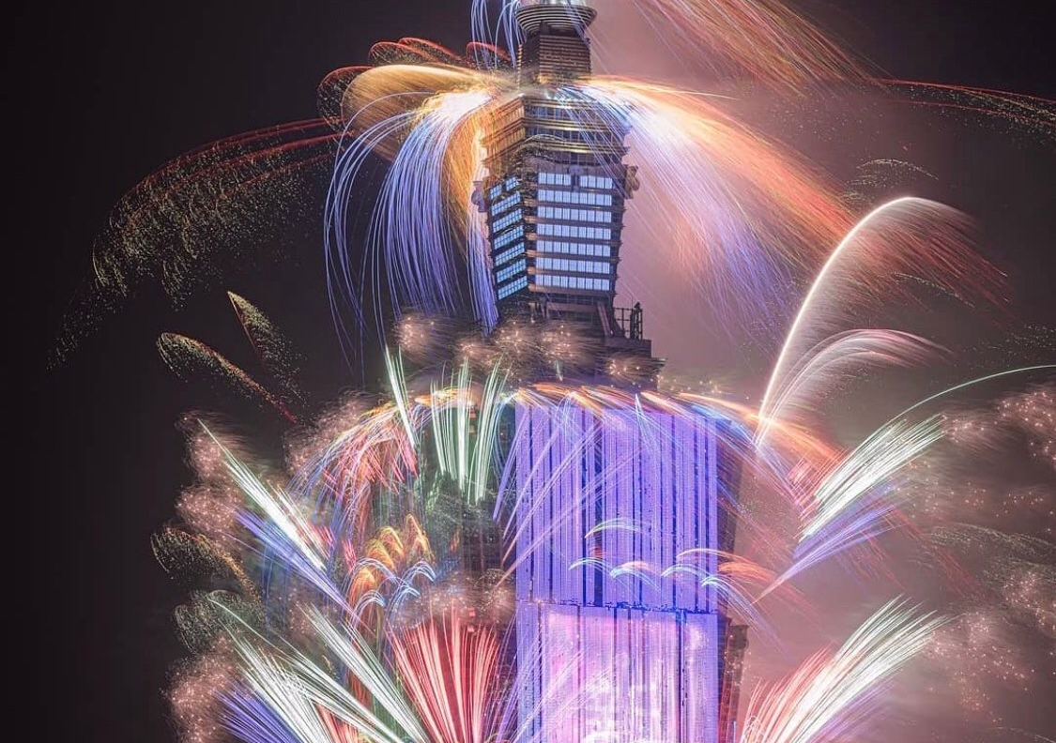
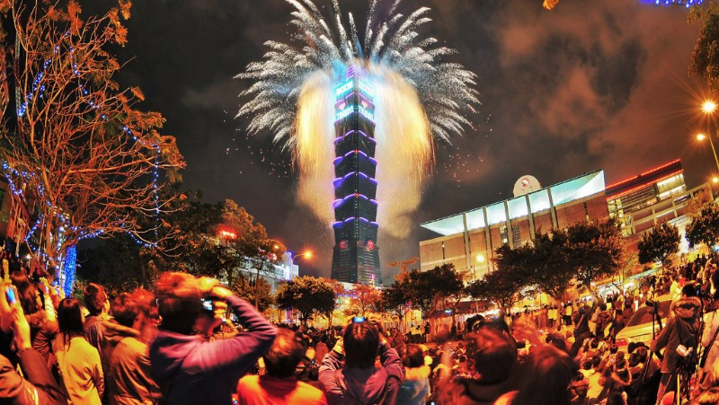
How is N.Y.E. celebrated in Taiwan
The most prominent New Year's event in Taiwan is a major fireworks show launched from the Taipei 101 skyscraper in Taipei. In 2018, the show was enhanced by the installation of a new LED display system on the north face of the tower between its 35th and 90th floors, which can be used to display digital animation effects. This change countered a reduction in the number of firework shells launched during the show, as part of an effort to produce less pollution

Slide 9
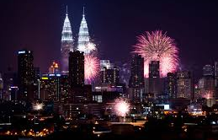
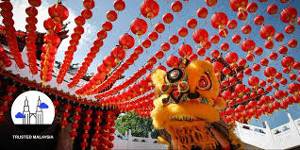
How is N.Y.E. celebrated in Malaysia
Ambang Tahun Baru, a celebration sponsored by the government was held at Merdeka Square, the field opposite the Sultan Abdul Samad Building in the Malaysian capital of Kuala Lumpur in the early days. The event was broadcast live on government as well as private TV stations at those times. The countdown is now broadcast live on Government television from Putrajaya and the Broadcasting Centre in which the concert is held and fireworks are displayed at the Petronas Towers.
There are New Year countdown parties in major cities such as George Town, Shah Alam and Kuching, typically organized by the private sector in these cities

Slide 10
How is N.Y.E. celebrated in Bosnia and Herzegovina
New Year is widely celebrated in Bosnia and Herzegovina. Streets are decorated for New Year's Eve and there is a fireworks show and concerts in all the larger cities. Restaurants, clubs, cafes and hotels are usually full of guests and they organize New Year's Eve parties.
In the capital Sarajevo, Bosnians gather in the Square of children of Sarajevo where a local rock band entertains them. Several trumpet and rock groups play until the early morning hours. At midnight there is a big fireworks show.

