Slide 1
My favorite singer
Tudor Tripa

Slide 2
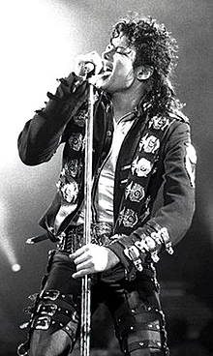

Michel Jackson
Michael Joseph Jackson (August 29, 1958 – June 25, 2009) was an American singer, songwriter, dancer, and philanthropist. Dubbed the "King of Pop", he is regarded as one of the most significant cultural figures of the 20th century. Over a four-decade career, his contributions to music, dance, and fashion, along with his publicized personal life, made him a global figure in popular culture. Jackson influenced artists across many music genres; through stage and video performances, he popularized complicated dance moves such as the moonwalk, to which he gave the name, as well as the robot

Slide 3
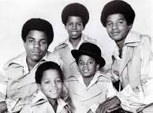
First Band
He’s the 18 child of the Jackson family .He made his public debut in 1964 with his older brothers Jackie, Tito, Jermaine, and Marlon as a member of the Jackson 5 (later known as the Jacksons). Jackson began his solo career in 1971 while at Motown Records.

Slide 4
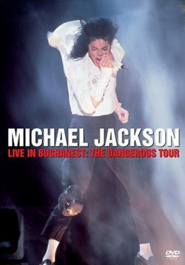
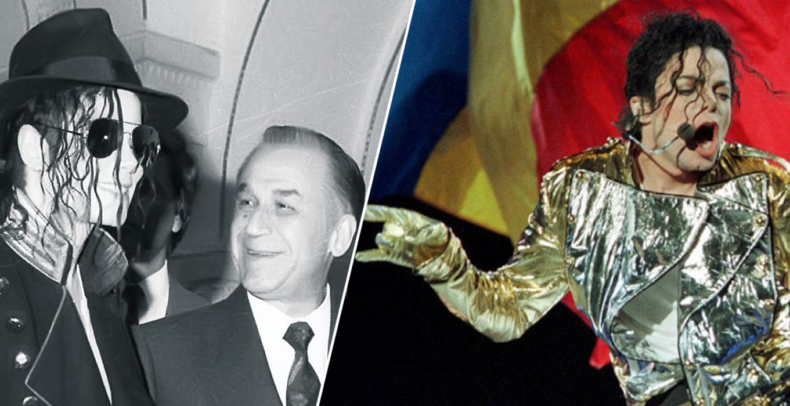
Concert in Romania
He had a concert in Bucarest in 1992
https://www.youtube.com/watch?v=OaOv0X4v610

Slide 5
Thanks 4 watching!!

