Slide 1
My favorite person

Slide 2
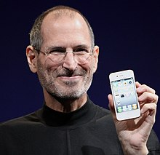
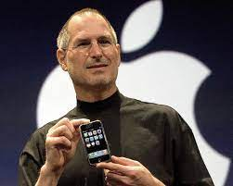
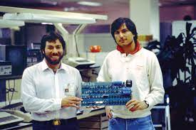
STEVE JOBS
Steven Paul Jobs (February 24, 1955 – October 5, 2011) was an American business magnate, industrial designer, media proprietor, and investor. He was the co-founder, chairman, and CEO of Apple; the chairman and majority shareholder of Pixar; a member of The Walt Disney Company's board of directors following the buying of Pixar; and the founder, chairman, and CEO of NeXT. He is widely recognized as a pioneer of the personal computer revolution of the 1970s and 1980s, along with his early business partner and fellow Apple co-founder Steve Wozniak.

Slide 3
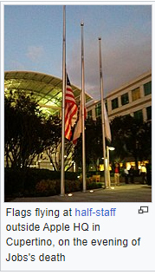
JOBS DEATH
Jobs died at his Palo Alto, California, home around 3 p.m. on October 5, 2011, due respiratory arrest. He had lost consciousness the day before and died with his wife, children, and sisters at his side.His sister, Mona Simpson, described his death thus: "Steve's final words, hours earlier, were monosyllables, repeated three times. Before embarking, he'd looked at his sister Patty, then for a long time at his children, then at his life's partner, Laurene, and then over their shoulders past them. Steve's final words were: 'Oh wow. Oh wow. Oh wow.'" He then lost consciousness and died several hours later. A small private funeral was held on October 7, 2011, the details of which, out of respect for Jobs's family, were not made public.

Slide 4
Thanks for watching!

