Slide 1
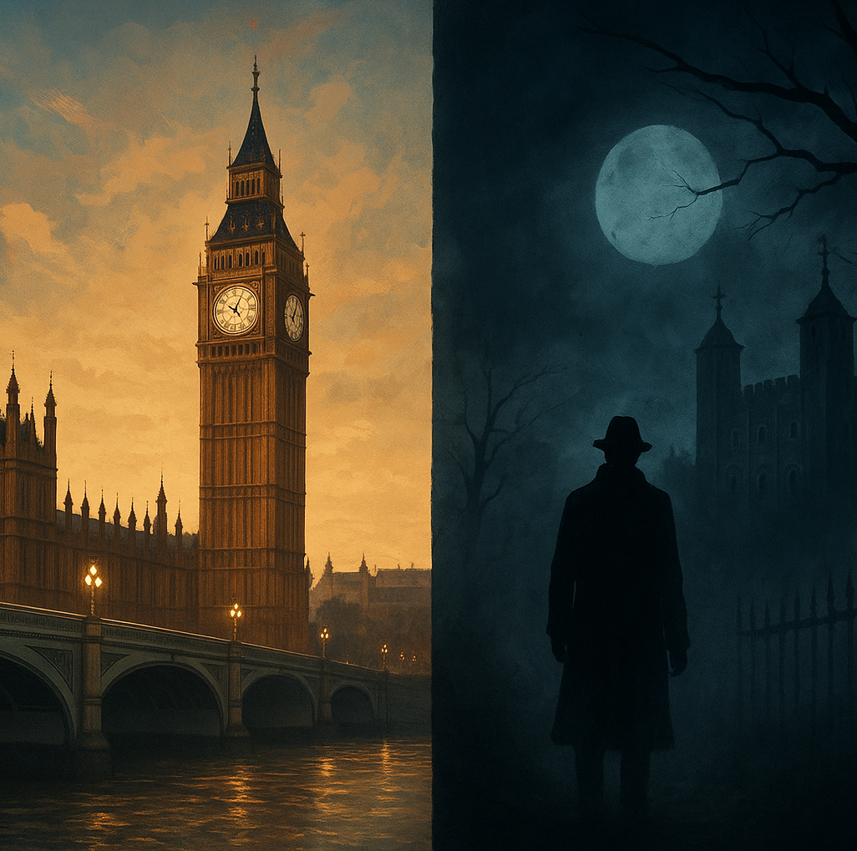
London and its crimes
Tudor Tripa
Class 7E

Slide 2
Introduction
Historics Crimes
Modern Crimes
Crime Scenes
Final

Slide 3
The city of Swadows
Back
What if the greatest stories of London aren't the ones about its queens and kings, but about the figures who lurked in its darkest corners? What if the city's most enduring symbols are the ghosts of its unsolved mysteries? In this presentation, we will explore into London's past.

Slide 4
Historic Crimes
Back
Jack the Ripper (1888):
  The most famous serial killer in London’s history
  Murdered at least five women in Whitechapel
  He was never caught — his identity remains a mystery
Sweeney Todd:
  The “Demon Barber of Fleet Street” who (in legend) killed his customers and baked them into pies.
  Possibly based on real stories from Victorian London
  perfect setting for crime.
26 April 1897:
A bomb left by an anarchist group on a Metropolitan Railway train exploded at Aldersgate Street station (now Barbican). One person, Harry Pitts, was killed and sixty were injured, ten seriously
Notes:
Victorian London looked elegant on the surface, but its shadows hid something terrifying.”

Slide 5
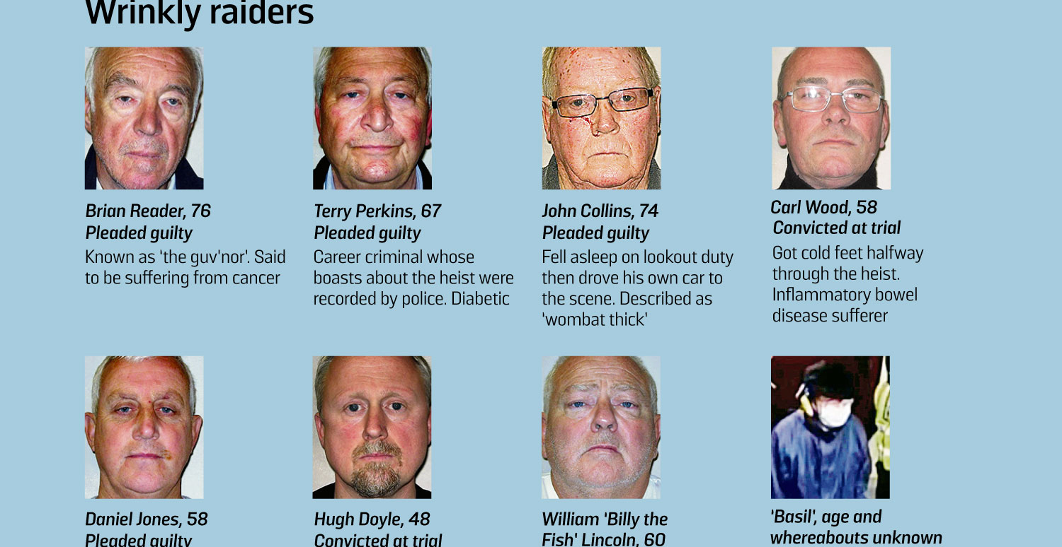
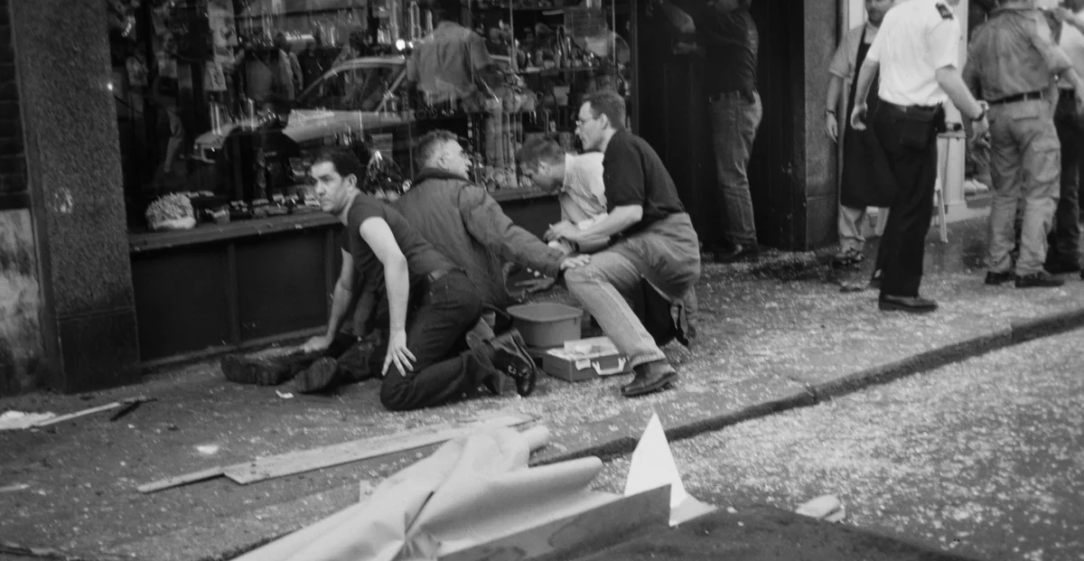
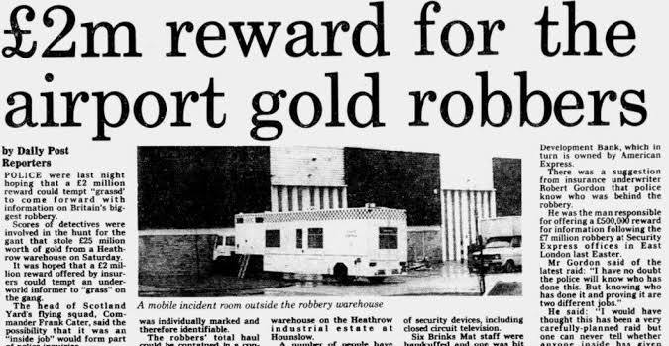
Modern Crimes
Back
Brinks-Mat Robbery (1983):
  Thieves stole £26 million in gold from Heathrow Airport — one of Britain’s biggest robberies.
Hatton Garden Heist (2015):
  A group of elderly men broke into a vault and stole £14 million in jewels — proving crime has no age
London Nail Bombings
  Electric Avenue bomb
  Brick Lane bomb
  Admiral Duncan bomb ( 3 victims )
Notes:
Aside the theves of phones something MAJOR:

Slide 6
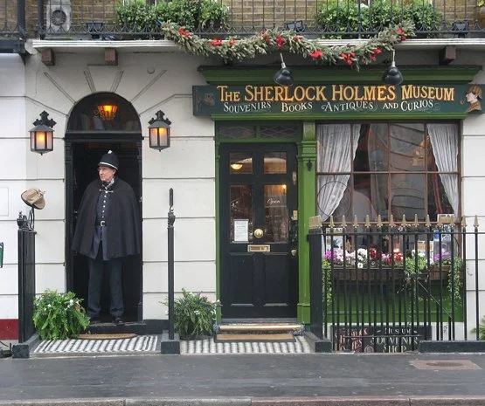
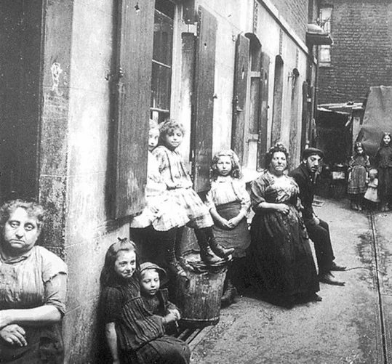
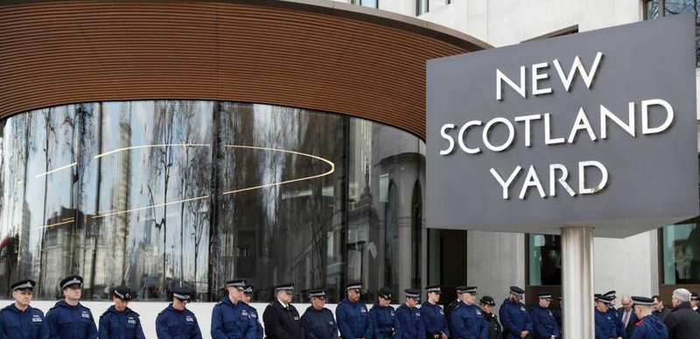
Where the Darkness Lives?
Back
Whitechapel: the area of Jack the Ripper’s murders.
Fleet Street: home of Sweeney Todd’s barbershop legend.
Tower of London: site of royal executions and ghost sightings.
Scotland Yard: headquarters of London’s police, solving countless mysteries.
Baker Street: fictional home of Sherlock Holmes — the world’s most famous detective.

Slide 7
Thank you for watching!
Notes:
London’s crimes tell us about fear, greed, and the search for justice.
They remind us how stories of murder and mystery can live on for centuries.
Today, London is safer — but its dark legends still attract millions of visitors every year.

