Slide 1
IN THE FUTURE
TUDOR TRIPA
FIFTH GRADE

Slide 2
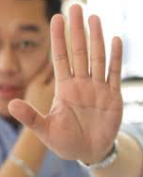

COMPUTERS
I think that in the future the computers will be a chip on your finger and laptops/computers will be in your brain, and WI-FI are in your brain also.

Slide 3
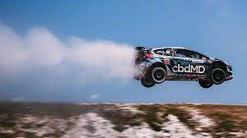
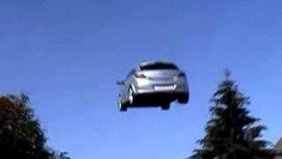
Roads
Roads should not exist anymore, because all cars can fly and park in the air

Slide 4
Thanks for watching!

