Slide 1
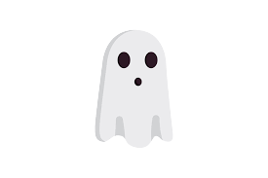
How Howelen
How is Halloween
celebrated inThe Uk ans USA

Slide 2
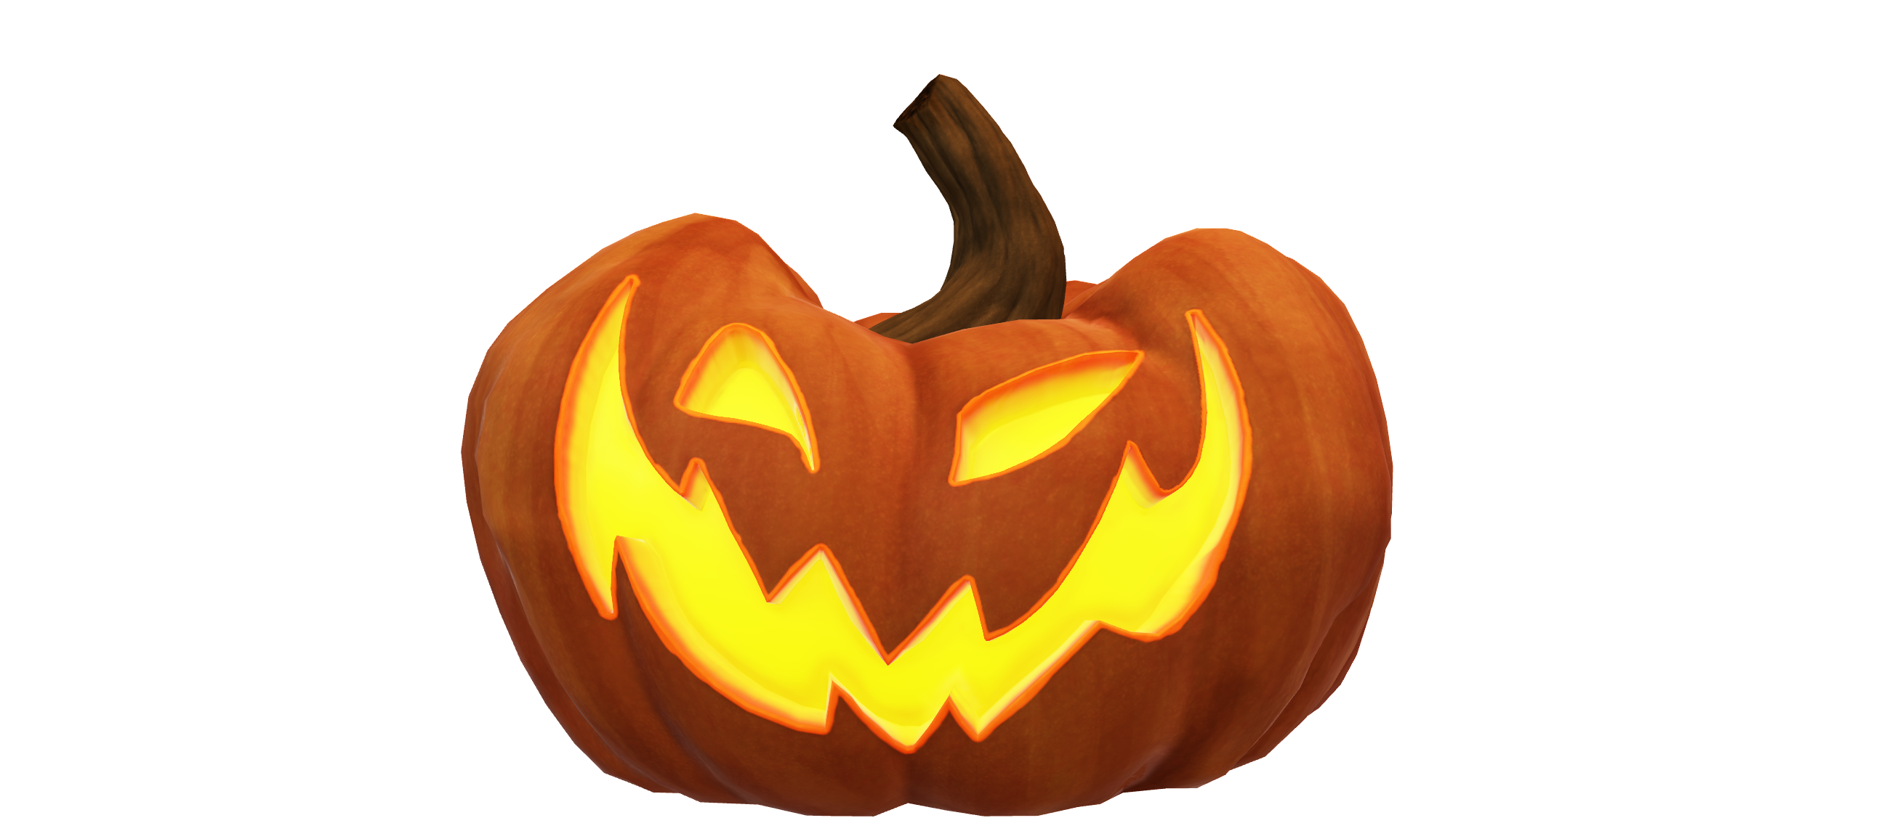
How Americans Celebrate Halloween

Slide 3
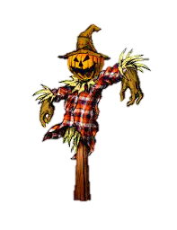
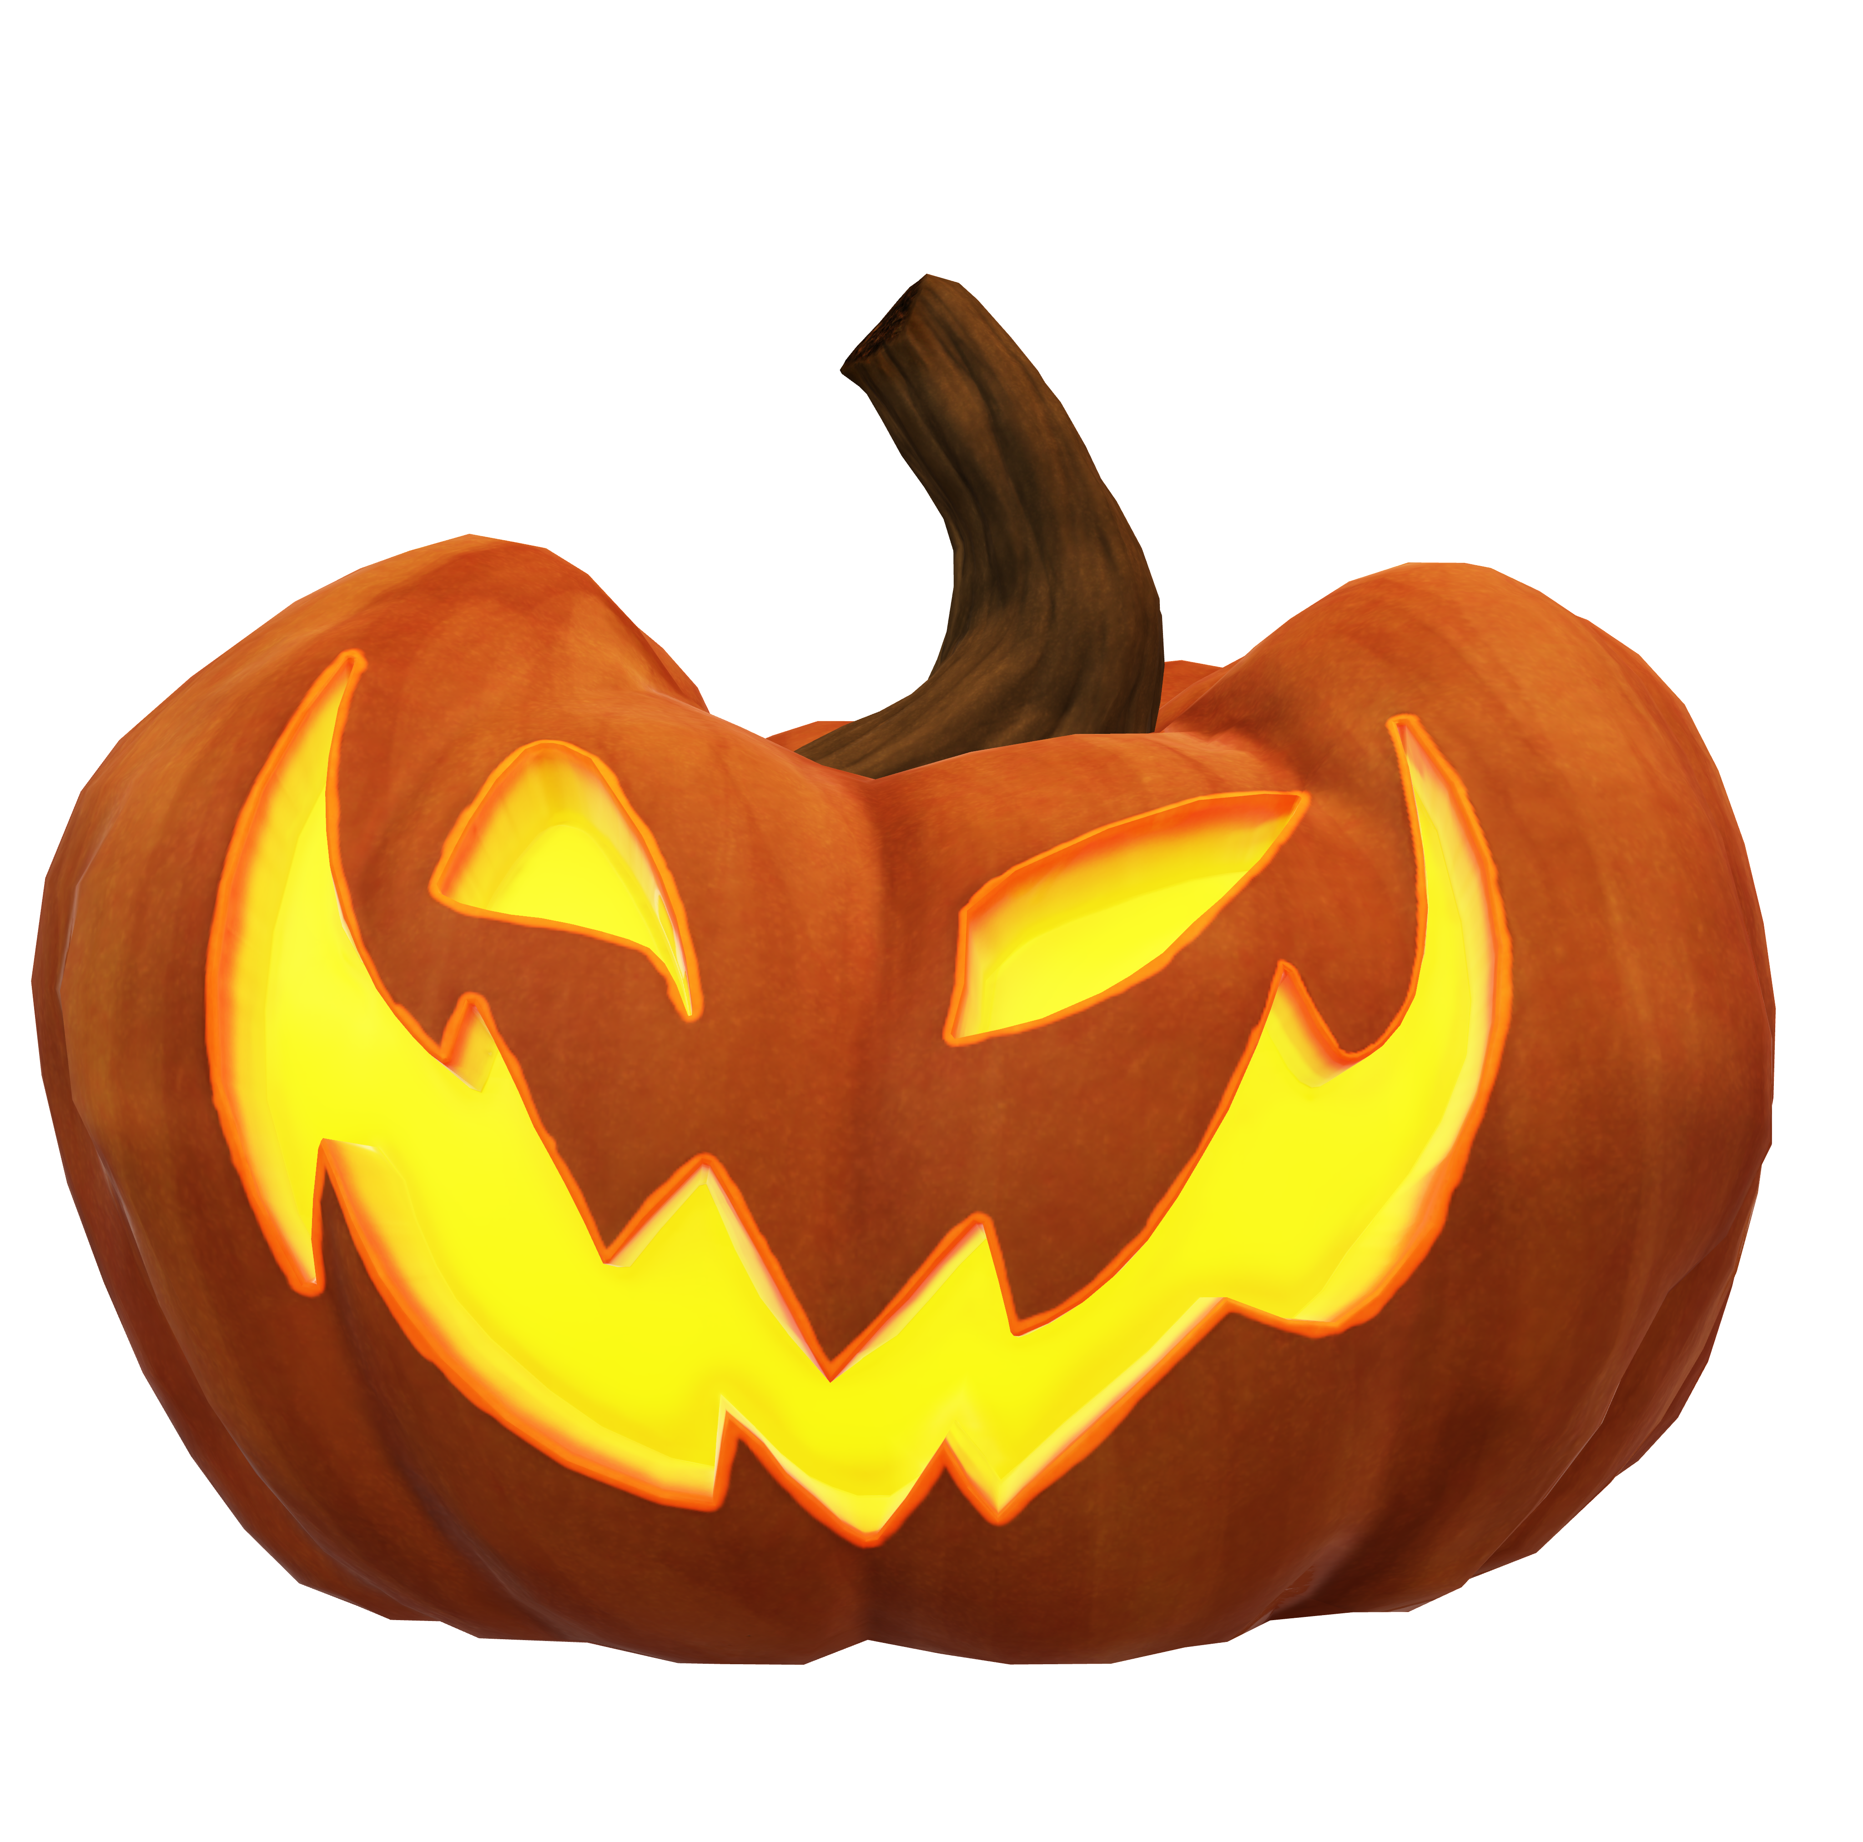
People still celebrate by wearing scary costumes. However, today they also dress up like popular celebrities, children's show characters, princesses, super heroes and much more. After dressing up, kids go trick-or-treating. They go from house to house in their neighborhoods and ask for treats such as candies and snacks by saying, “Trick or treat!” According to tradition, if no treat is given, they can play a trick on the homeowners. The traditional scary and modern fun sides of
Many people also make Jack-o'-lanterns that people create by carving scary faces on pumpkins. Homeowners place Jack-o'-lanterns in front of their houses to scare evil spirits and to welcome trick-or-treaters..

Slide 4
Halloween include watching horror movies and visiting haunted houses.
The celebration in the United States has spread to other countries throughout the world as a fun and commercial event. Today many people celebrate Halloween with costumes and candy, without knowing the history of the traditions. In addition, some organizations including UNICEF use the same concept of trick-or-treat to ask for money for fund raising to be used to help people in need around world.

Slide 5
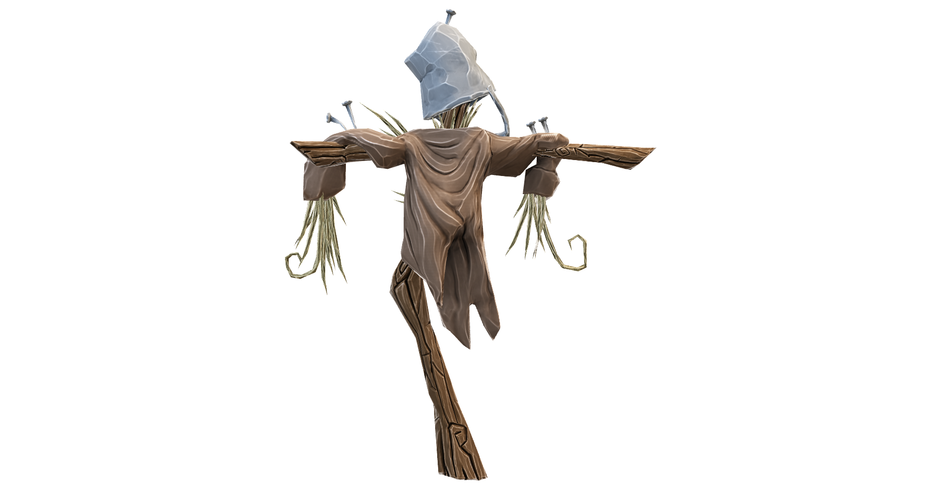
How The UK Celebrates Halloween

Slide 6

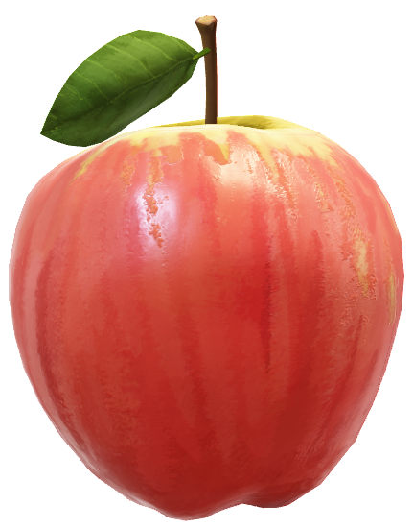
Throughout Britain, Halloween has traditionally been celebrated by children’s games such as bobbing for apples in containers full of water, telling ghost stories and the carving of faces into hollowed-out vegetables such as swedes and turnips. These faces would usually be illuminated from within by a candle, the lanterns displayed on window sills to ward off any evil spirits. The current use of pumpkins is a relatively modern innovation imported from the United States, and we can also extend the same debt of gratitude to our friends in America for that ‘quaint’ “trick-or-treat” tradition!

Slide 7
THE END

