Slide 1
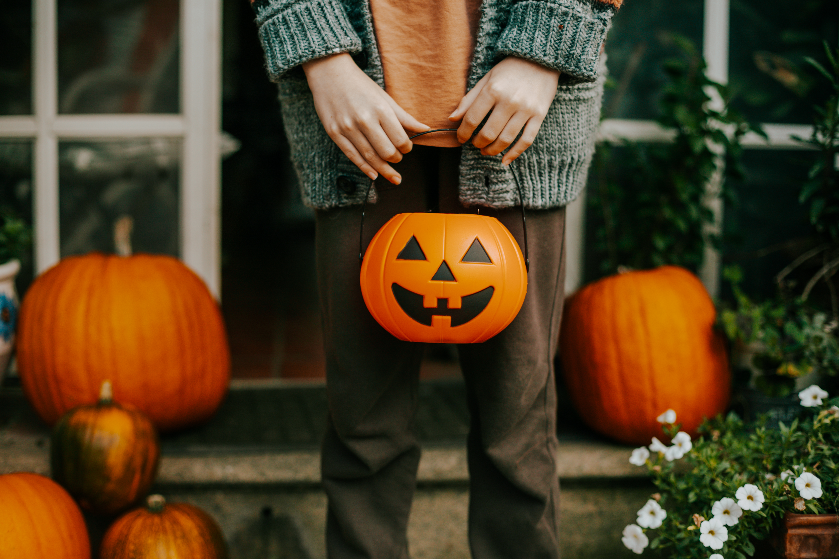
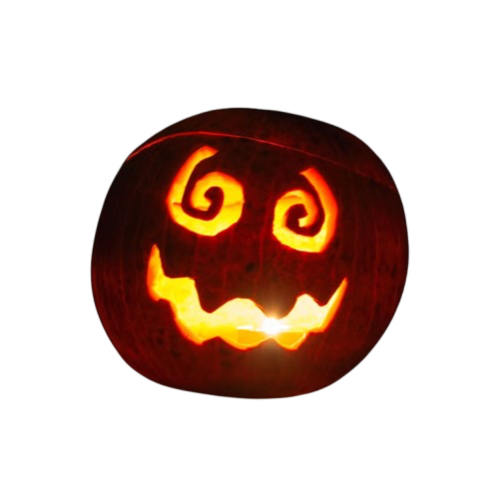
Halloween
Tudor Tripa

Slide 2
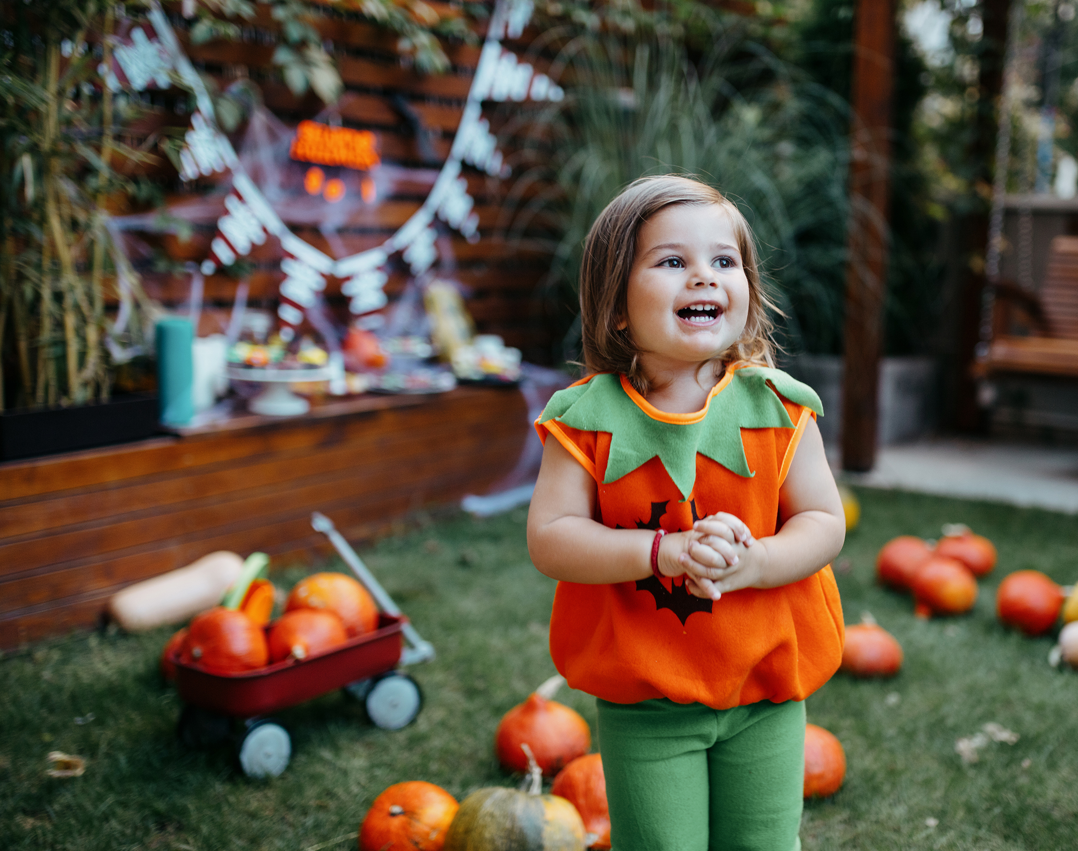
About
Halloween is a holiday of Celtic origin, spread in the 19th century by Irish immigrants to the United States, and celebrated on the night of October 31. The name comes from the expression "All Hallows' Eve" and is related to the Feast of All Saints, celebrated in Western Christianity on November 1.
Among the traditional Halloween activities are wearing costumes, carving pumpkins, trick-or-treating, and visiting haunted places. In many countries, the holiday includes parades and carnivals, and children dress up as characters such as witches or mummies

Slide 3
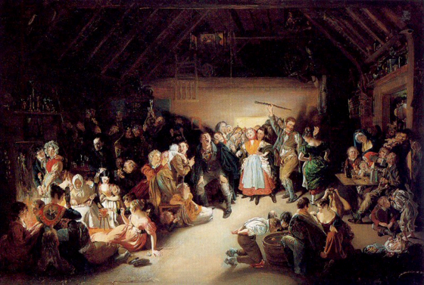
The history of Halloween
Halloween has been influenced by various cultures over time, such as the Celtic festival Samhain, the Roman festival of Pomona, and the Christian Feast of All Saints. Historian Nicholas Rogers notes that while some folklorists trace its origins to the Roman celebration of Pomona, goddess of fruits and seeds, or the festival of the dead called Parentalia, Halloween is most commonly linked to the Celtic festival Samhain, originally spelled Samuin. The name comes from Old Irish and means "end of summer."
Snap-Apple Night de Daniel Maclise prezentând o petrecere de Halloween în Blarney, Irlanda, în 1832

Slide 4
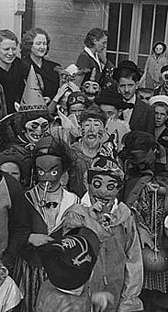
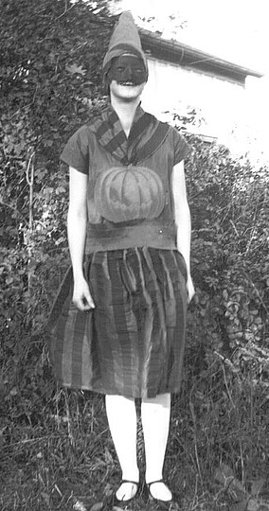
Treat or Trick
Halloween trick-or-treating involves children going from house to house dressed in costumes, asking for candy with the phrase "Trick or Treat?" as a playful threat to perform pranks if they don’t receive sweets. The custom was popular in Scotland and Ireland since the 16th century, and it was first recorded in North America in 1911. In the United States and Canada, trick-or-treating is the main Halloween tradition, which later spread to other countries along with other Halloween events.

Slide 5

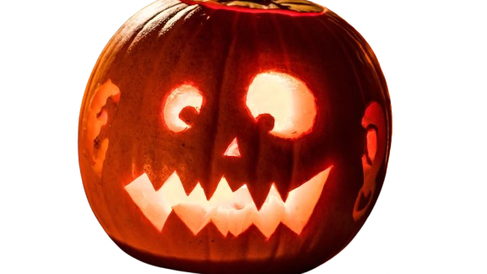
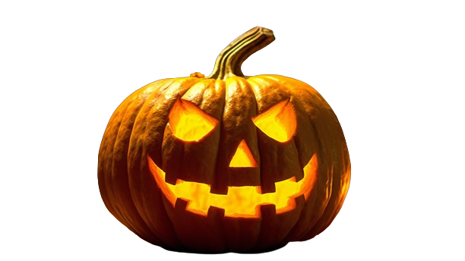
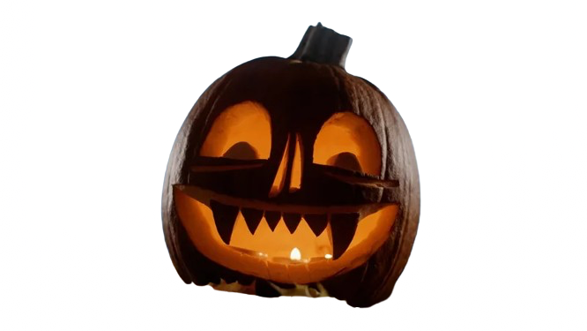
Thanks for watching

