Slide 1
Christmas Customs
By tudor tripa, fifth grade

Slide 2
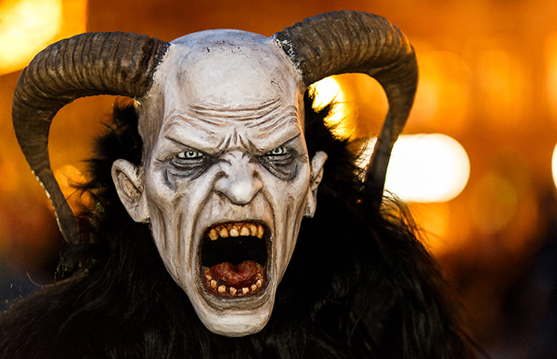
Austria
A beast-like demon creature that roams city streets frightening kids and punishing the bad ones – nope, this isn’t Halloween, but St. Nicholas’ evil accomplice, Krampus. In Austrian tradition, St. Nicholas rewards nice little boys and girls, while Krampus is said to capture the naughtiest children and whisk them away in his sack. In the first week of December, young men dress up as the Krampus (especially on the eve of St. Nicholas Day) frightening children with clattering chains and bells.

Slide 3
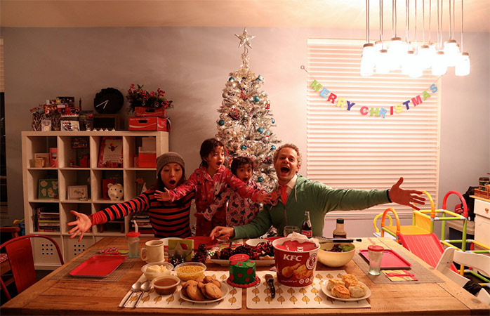
Japan
Christmas has never been a big deal in Japan. Aside from a few small, secular traditions such as gift-giving and light displays, Christmas remains largely a novelty in the country. However, a new, quirky “tradition” has emerged in recent years – a Christmas Day feast of the Colonel’s very own Kentucky Fried Chicken.
Want to leave?

Slide 4
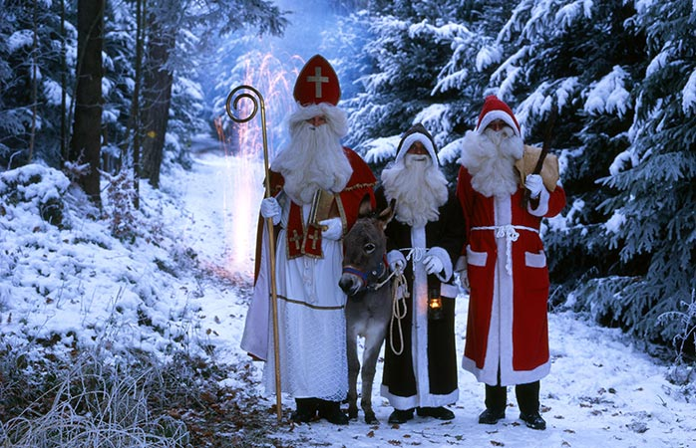
Germany
Not to be confused with Weihnachtsmann (Father Christmas), Nikolaus travels by donkey in the middle of the night on December 6 (Nikolaus Tag) and leaves little treats like coins, chocolate, oranges and toys in the shoes of good children all over Germany, and particularly in the Bavarian region. St. Nicholas also visits children in schools or at home and in exchange for sweets or a small present each child must recite a poem, sing a song or draw a picture. In short, he’s a great guy. But it isn’t always fun and games. St. Nick often brings along Knecht Ruprecht (Farmhand Rupert). A devil-like character dressed in dark clothes covered with bells and a dirty beard, Knecht Ruprecht carries a stick or a small whip in hand to punish any children who misbehave.

Slide 5
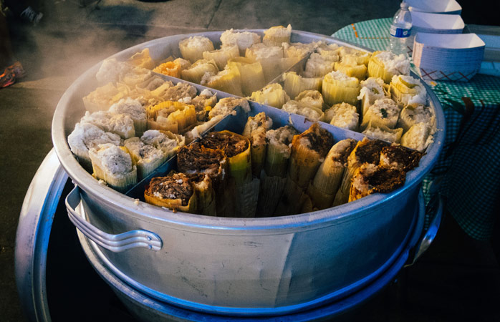
Venzuela
Every Christmas Eve, the city’s residents head to church in the early morning – so far, so normal – but, for reasons known only to them, they do so on roller skates. This unique tradition is so popular that roads across the city are closed to cars so that people can skate to church in safety, before heading home for the less-than-traditional Christmas dinner of ‘tamales’ (a wrap made out of cornmeal dough and stuffed with meat, then steamed).

Slide 6
Thank you 4 Wathing
Did you have fun?

